Slide 1

Precautionary Search & Landing

Slide 2
Housekeeping
60 minutes
Emergency exit, toilet, kitchen

Slide 3
Aim
To learn how to safely locate, correctly inspect and carry out a power assisted landing into a suitable field.
Notes:
difference between PFL & PSL

Slide 4
Motivation
The precautionary search and landing is one of the most valuable tools that a pilot has at his or her disposal to prevent an urgent situation turning into an emergency.
Notes:
Last light, deteriorating weather

Slide 5
Overview
Objectives
Revision
Considerations
Application
Airmanship
TEM
Summary
Objectives – revisited

Slide 6
Objectives
At the end of the briefing, you will be able to, from memory and without mistake:
State two reasons why it would be necessary to conduct a precautionary search and landing.
State the procedure to follow for the first inspection run.
State the mathematical method for estimating the strip length.
Identify and management 2 airborne threats.

Slide 7
Revision
Describe an appropriate field for forced landing
WOSSSSS
State the configuration for safe slow cruise
2 stages of flap, 2100 RPM, airspeed 75-80 KIAS

Slide 8
Definitions
Aircraft Landing Area (ALA):
An area of land suitable for use for the landing or take-off of aircraft. This typically, is an unlicensed or unregistered aerodrome such as one found in the country on private properties or could be a paddock or clearing as also found in the outback.

Slide 9
Definitions
RAF
Reference Point: A point in the distance to assist with directional guidance
Airspeed: To be monitored closely due to close proximity of the terrain
Field: The proposed landing field

Slide 10
Considerations
Why we conduct a precautionary search and landing?
Running out of the daylight
Deteriorating weather
Becoming lost
Engine or airframe problems
A low fuel state
Notes:
The difficulties that u encountered are usually compounded.
Weather is deteriorating and need to divert, likelihood of becoming lost increases, which in turn leads to a shortage of fuel and closer to the end of daylight.

Slide 11
Considerations
Risks with low level flying?
Turbulence
Power line
Illusion (wind)
Notes:
CAR 157
As the wind blows over the ground it is forced to change direction causing it to become turbulent
Hard to see

Slide 12
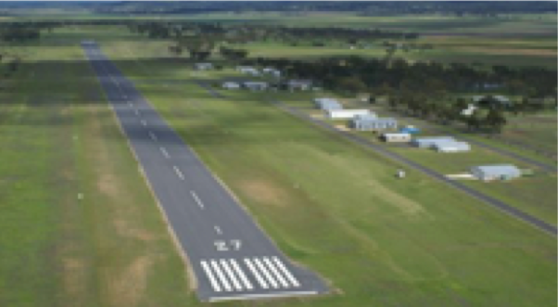
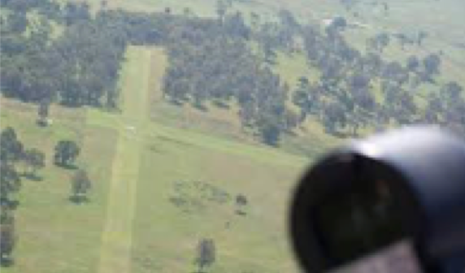
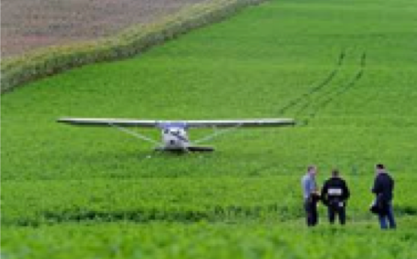
Considerations – Field selection
Active aerodrome
Unused aerodrome / ALA
A suitable field
Notes:
The first choice will obviously be an active aerodrome, the second could be an unused one, and finally, if neither are available, you must choose a field using the same selection criteria as you use for a forced landing.

Slide 13
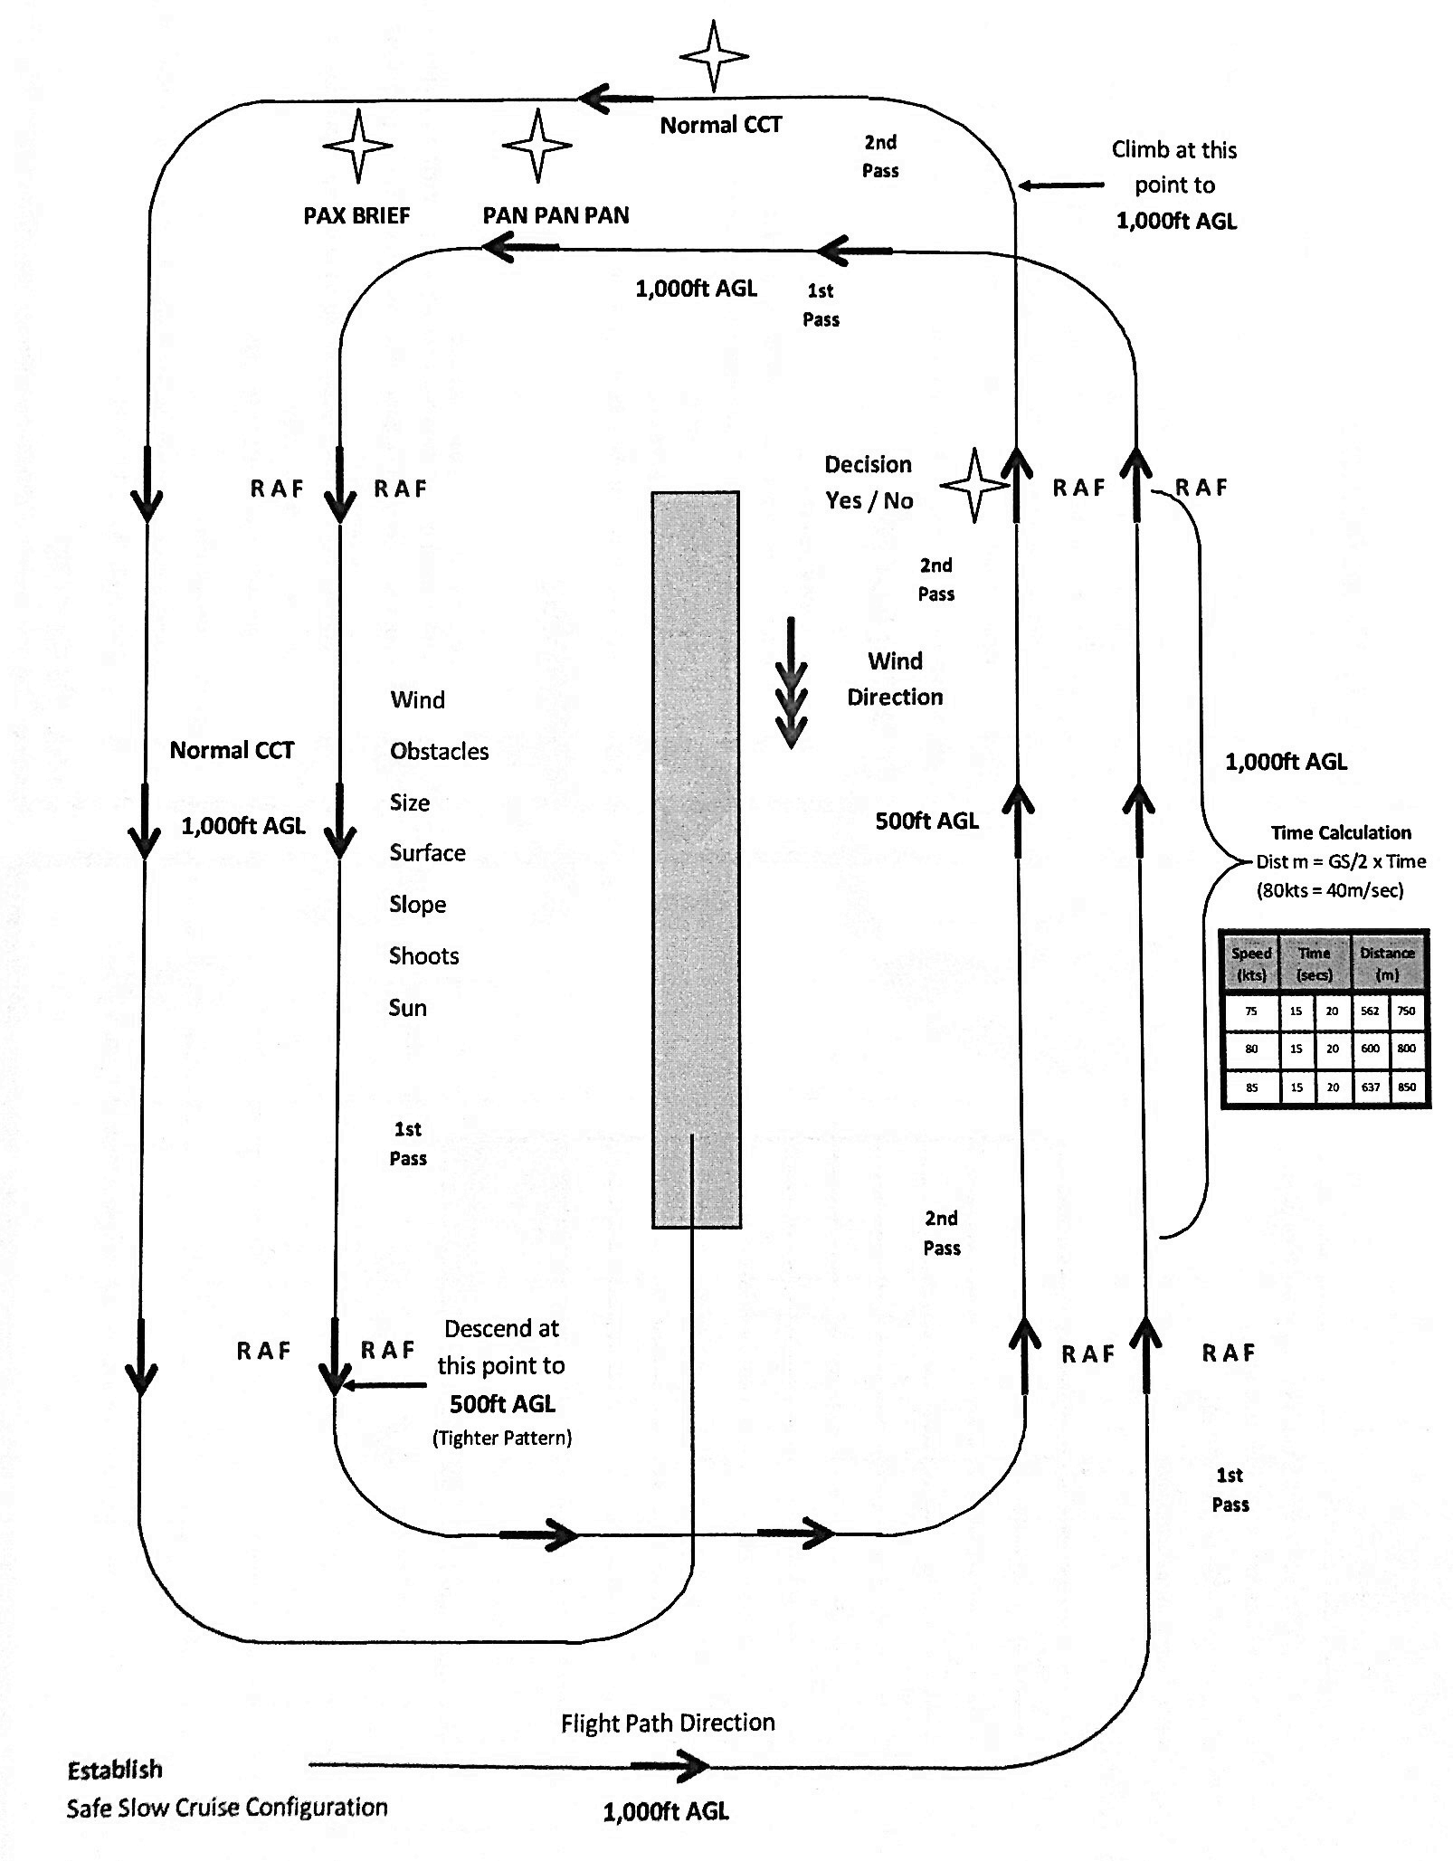
Application
Conduct 2 circuits
High pass – 1000 ft AGL
Low pass – 500 ft AGL
Final approach

Slide 14
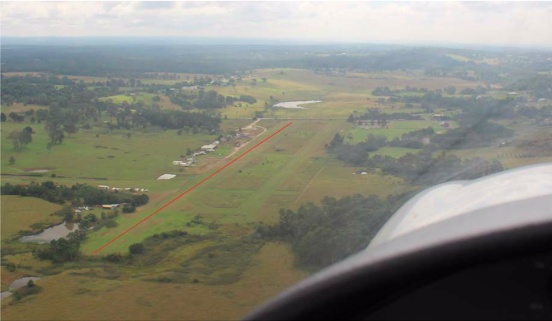
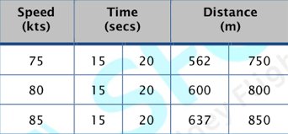
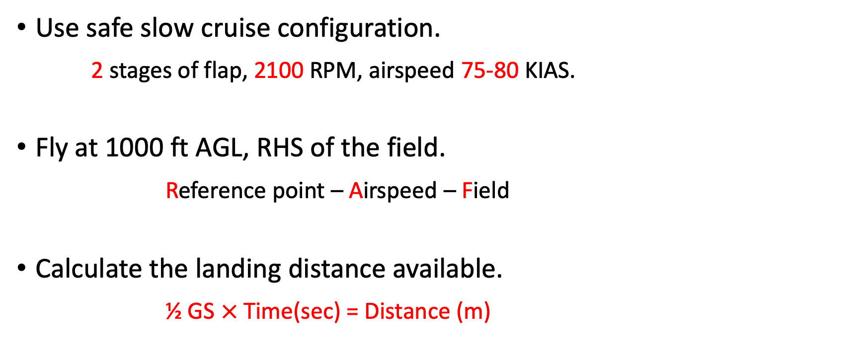
Application – The First Circuit
Use safe slow cruise configuration.
2 stages of flap, 2100 RPM, airspeed 75-80 KIAS.
Fly at 1000 ft AGL, RHS of the field.
Reference point – Airspeed – Field
Calculate the landing distance available.
½ GS $×$Time(sec) = Distance (m)
Notes:
RAF. Don't turn away from the field.
Start timing as the start of the field reaches the leading edge of the wing and finish when the end of the field is reached.
(drawing on board)
Access the field during the first circuit
Slip and skid

Slide 15
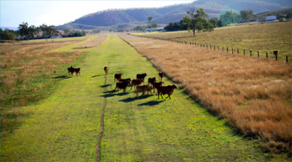
Application – The Second Circuit
Descend to 500 ft AGL. Fly a tighter pattern to proposed landing area.
Thorough inspection using WOSSSSS. Decision Yes/no ?
Climb back up to 1000 ft AGL if safe to do so. PAN PAN, PAX brief.
Notes:
If yes, continue
If no select a new field
PAX brief : pull out QRH, involve the pax

Slide 16
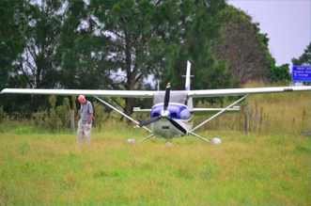
Application – Final Approach & Landing
Downwind – BUMFISH
The landing will be a short field landing

Slide 17
Airmanship
Aviate – Navigate – Communicate
Lookout
Fixation
Notes:
Low level

Slide 18
Threat and error management
Threat | Error | Management | UAS
Low visibility | Losing sight of the field |  | Disorientation
Low level | Poor lookout Not maintaining height | Good scan Inspect for obstacles
 | Poor field analysis | WOSSSSS Select another field | Landing on unsuitable area
RAF
Don’t turn away from
the field
Collision with obstacle
or terrain
Unsuitable field

Slide 19
Summary
Considerations about PSL
Field selection and application

Slide 20
Objectives – revisited
State two reasons why it would be necessary to conduct a precautionary search and landing.
State the procedure to follow for the first inspection run.
State the mathematical method for estimating the strip length.
Identify and management 2 airborne threats.

Slide 21

The End

